Slide 1
TG Registration & Administration

Slide 2
Table of Contents
REGISTRATION & ADMINISTRATION - FUNCTIONAL OVERVIEW
COMPONENTS AND COMPONENT INTERACTION
FEATURE DESCRIPTION
INVITATION -> SELF REGISTRATION -> APPROVAL
COMPANY & USER MANAGEMENT
GXS USER - ADMINISTRATIVE CAPABILITIES
SERVICE SUBSCRIPTIONS & PRICING
MESSAGING ADMINISTRATION
RESELLER SUPPORT
SAS 70 COMPLIANCE – INTERNAL USER ADMINISTRATION

Slide 3
REGISTRATION & ADMINISTRATION
FUNCTIONAL OVERVIEW

Slide 4
Registration & Invitation
Company Self-Registration involves creating an identity of new Company and its Users, on Trading Grid, essential to their using services offered on the Trading Grid.
New companies and users register on Trading Grid Online and subscribe to services like: TGMS, IWFS, File Services, TGE, OLV etc.
Upon successful registration customer is all set to transact and use the services.
Only one Self-Registration may be performed against one UNIQUE Invitation.
Multiple Self-Registrations may be performed against one GENERIC Invitation.
Registration may be AUTO APPROVED or may require MANUAL APPROVAL.
Registration may involve setting up of initial Trading Partnership with the Inviting Company or Not so in case of Registration against Open Invitation.

Slide 5
Administration
Includes Administration of -
Company
Users &User Access
Service Contacts
Invitation
Approval
Password Policy
T&C
Mailbox
EDI Address
Trading Partnership
Auto-forwards
Auto-Copy Distribution List
Service Subscription
Reseller Support
Solution Provisioning
Company / Business Unit
Has 1...n
Contains 1..n
Subscribed to
1..n
Users
Service Bundle
Mailbox
Contains 1..n
Is Granted
Subscription Package
Contains 0..n
Is Granted 1…n
Contains 1..n
EDI Address
Role
Service Instance

Slide 6
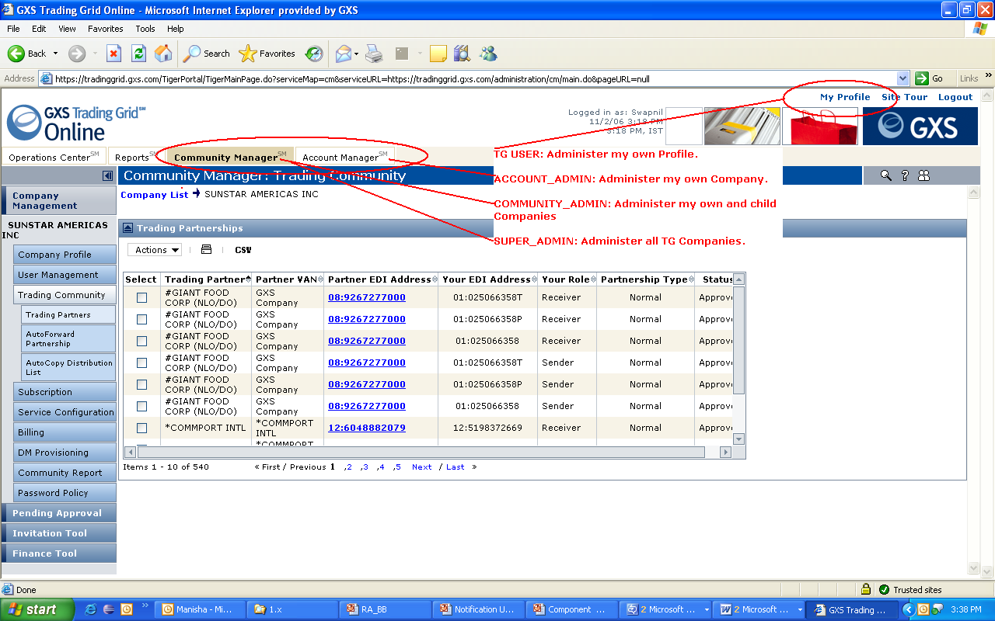
Administration Functional Overview

Slide 7
Administrative Capabilities for GXS user
Act on Behalf of Customer users
My Support List
Elaborate Search Options
Company
User
Trading Partnerships
Invitations
Solution Provisioning – Template based creation for Service Offerings for customers.

Slide 8
COMPONENTS & COMPONENT INTERACTION

Slide 9
Components
REGISTRATION
ADMINISTRATION
MESSAGING ADMINISTRATION
SUBSCRIPTION
RA-BSAPI

Slide 10
Overview: Component Interaction
URL IN
INVITATION
EMAIL
INVIATION
CODE
REGISTRATION
Browser based self registration
company / user
Service Subscription Options
Payment Options
Company Profile
User Profile
Messaging Details
RA DB
Invitation &
Registration
Details
Registration
Data
Held as key-
Value pair.
TGO
PORTAL
Click
Register
Link or
Login.
INVIATION
CODE
SUBMIT
IDENTITY
MANAGER
ACCOUNTING
FIA
TGMS
BIZ
SMG
ADMINISTRATION
ACCOUNT MANAGER / COMMUNITY MANAGER / MY PROFILE
LOGIN
SUBSCRIPTION
Service Subscriptions
Pricing Subscriptions
Mailbox Mgmt
MESSAGING ADMIN
EDI & MB Mgmt
Trading Partnerships
MailSlots
Autoforward
Autocopy
ADMINISTRATION
Invitation & Approval
Company / User Mgmt
Password Policy
Service Contacts
Legal Profiles
APPROVE
INVITE
NOTIFICATION
MESSAGE CENTER &
PERSONALIZATION
CDUC
TGES
SUPPORT

Slide 11
FEATURE DESCRIPTION
INVITATION -> SELF REGISTRATION -> APPROVAL

Slide 12
Invitations
Invitation includes following attributes:
Inviting Company: Invitation email notification goes out on behalf of the inviting company.
User vs. Company Invitations: Company and first user can register against Company invitations.
Auto Approval vs. Manual Approval: Registrations against Auto invitations are automatically approved.
Unique vs. Generic Invitations: Unique invitations generate as many invitation codes as the recipients and each invitation code can be used to register once. Generic invitations generate one invitation code which can be re-used to register more than once.
Expiration Date: Registration cannot be performed post the expiration date of an invitation.

Slide 13
Invitations
Cont..
Pricing Details: Price bundle, who pays (inviting company/ invitee) etc. is captured in invitation.
Services invited for: Inviting company in eligible to invite other companies for services it sponsors or the generic Trading Grid services like ICS.
Inviter and optionally Invitee EDI address: Inviter and Invitee EDI address are used post registration to create an initial EDI address to EDI address trading partnership.
Recipient email addresses
Invitation Email language and content: Inviter may edit the email contents using WYSWYG editor, choose one of the supported language or, upload an image to be included in the email notification.

Slide 14
Invitations
Bulk Upload of Recipients
Copy Invitation
Elaborate Invitation search options
Send invite on behalf of multiple companies

Slide 15
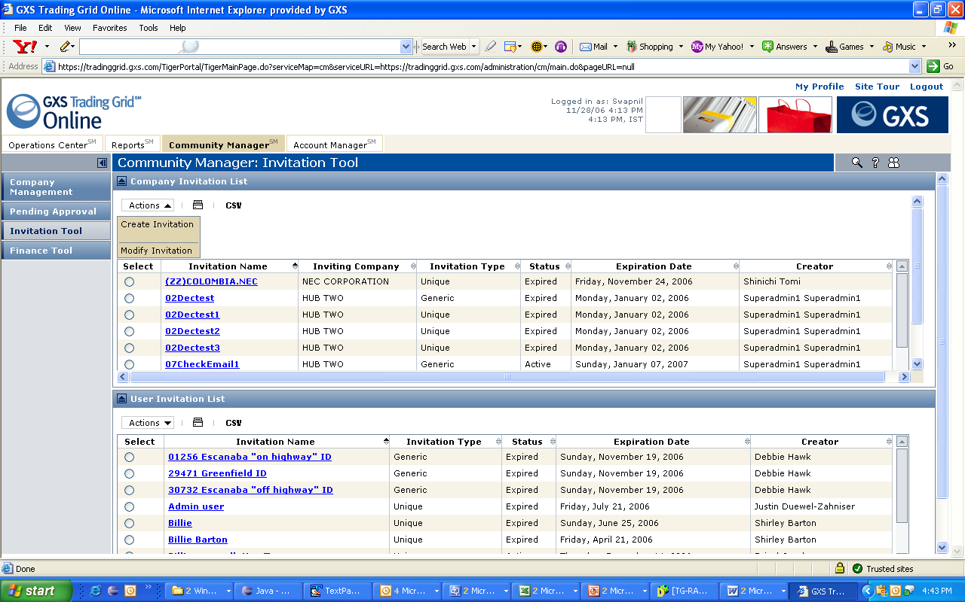
Invitation List

Slide 16
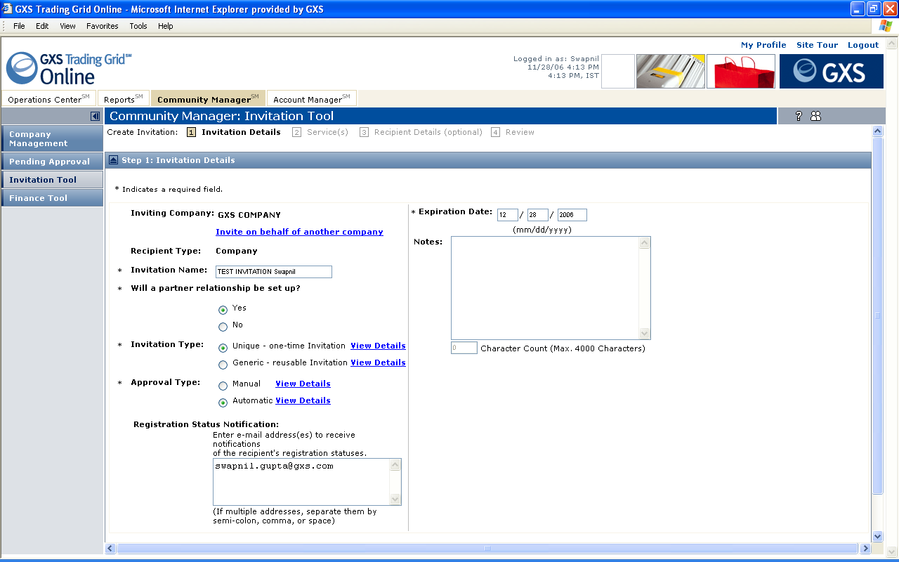
Create Company Invitation
1. Invitation Details.

Slide 17
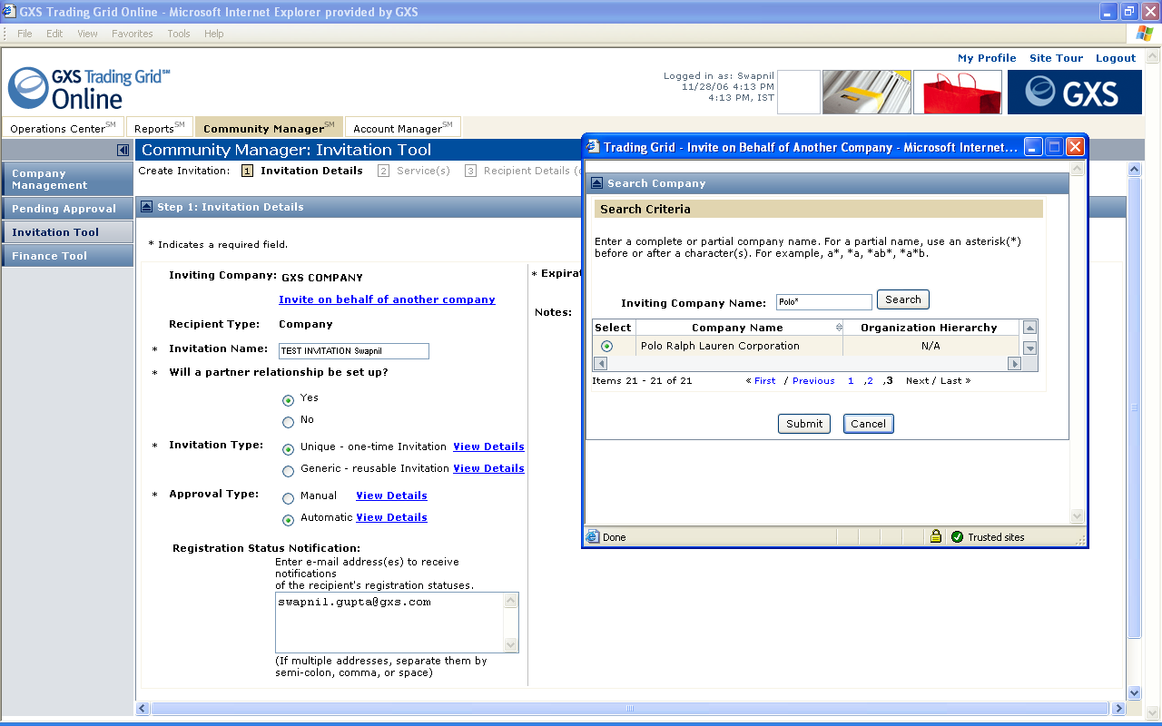
Create Company Invitation
1. Invitation Details: GXS Super Admin can create invitations on behalf of other companies.

Slide 18
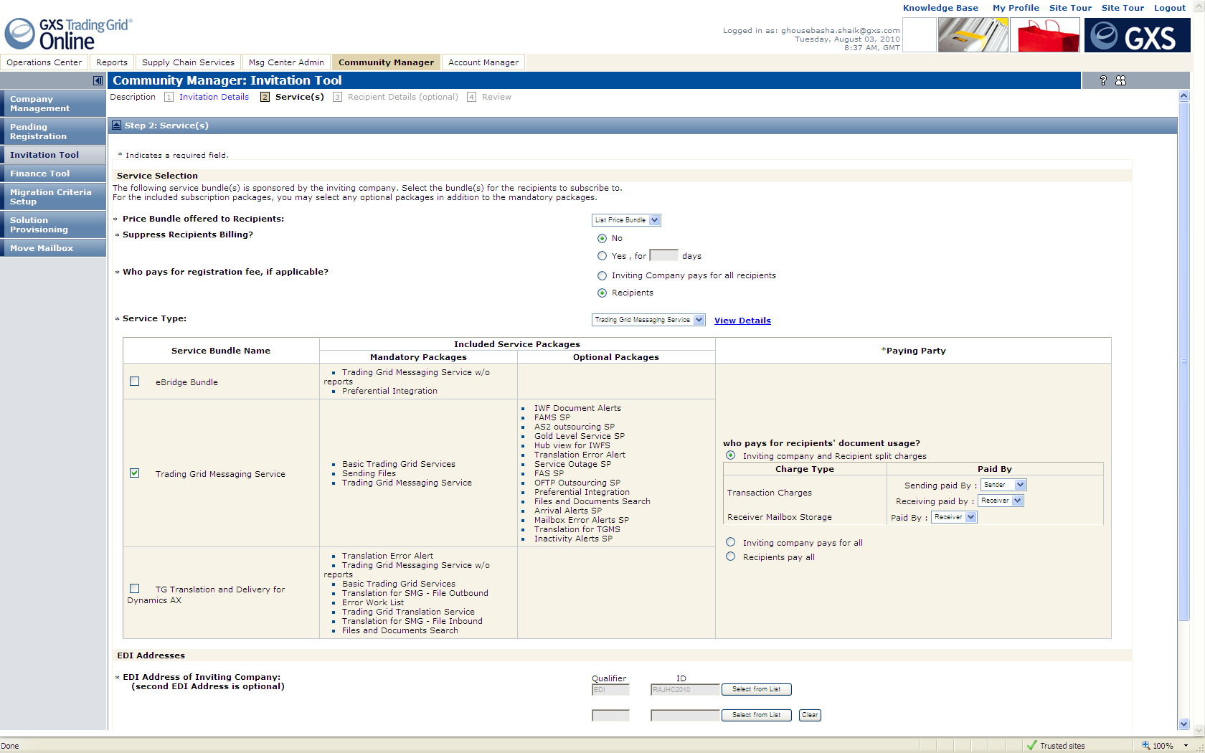
Create Company Invitation
2. Services: Pricing, Services and EDI address for self and partner need to be specified in this step.

Slide 19
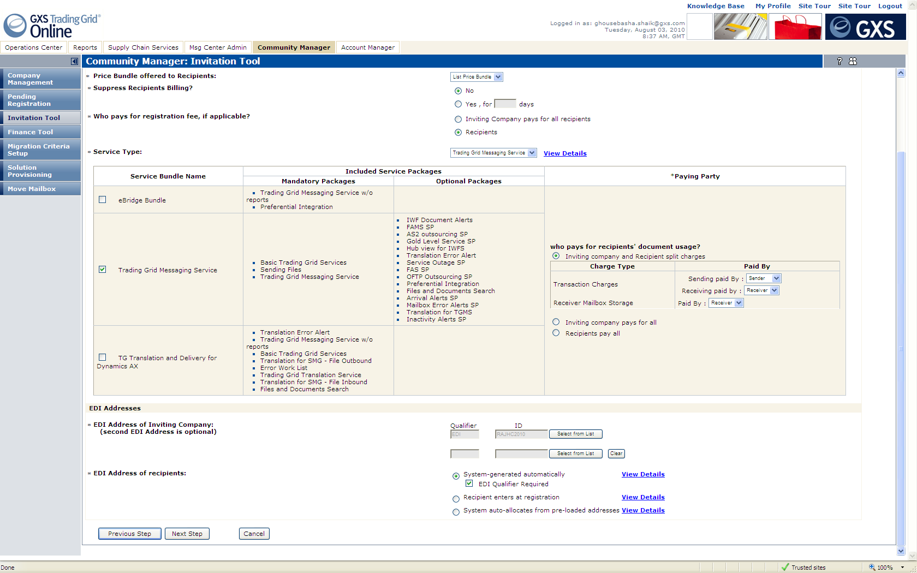
Create Company Invitation
2. Services: Services which are sponsored by the inviting company or Generic services may be included in invitation.

Slide 20
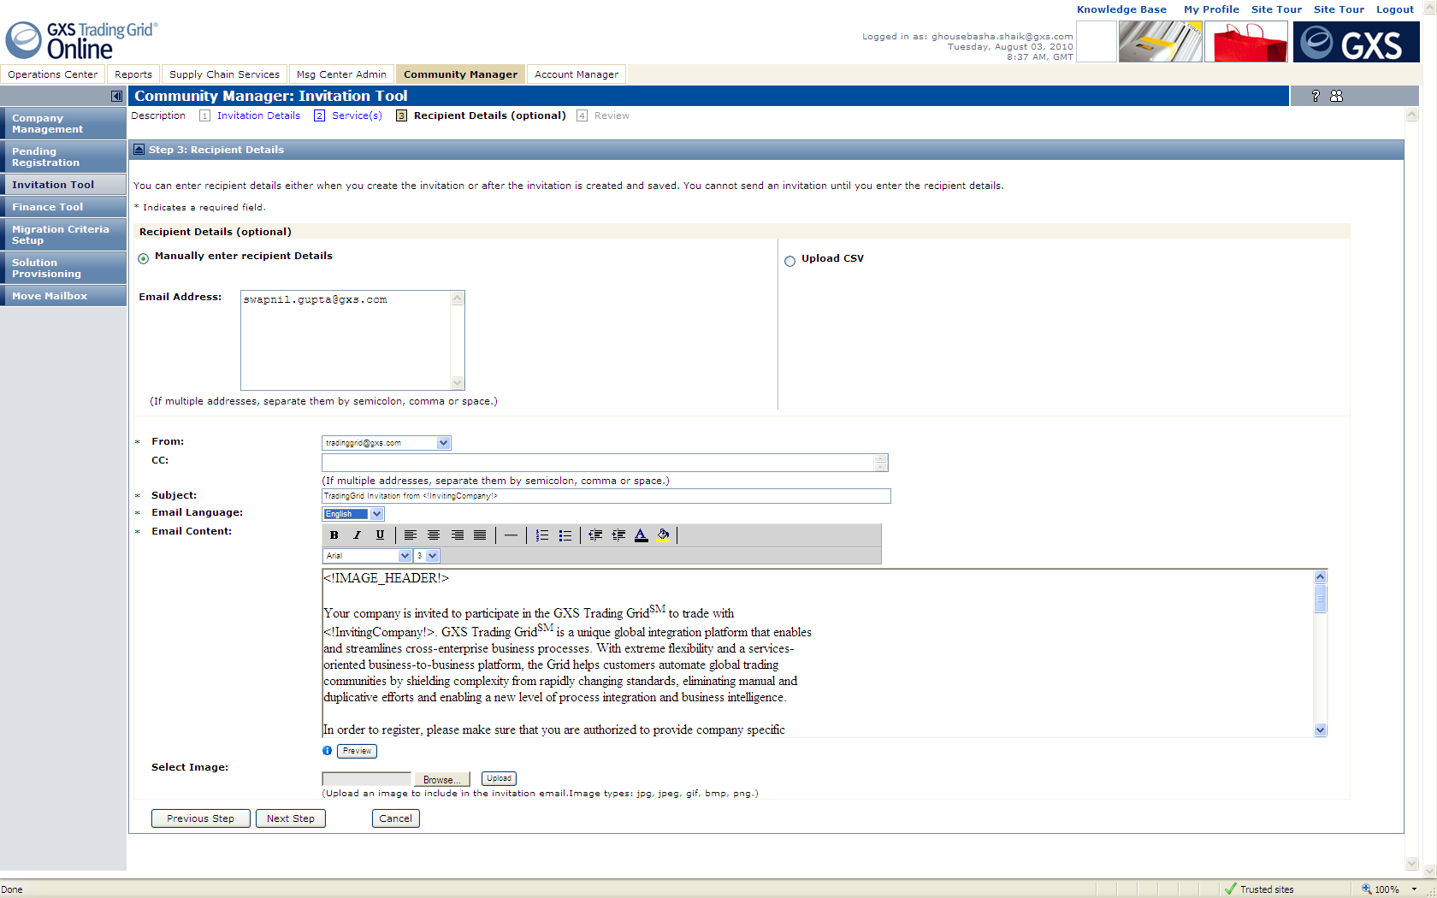
Create Company Invitation
3. Recipients: If option “System-generated automatically” / “Recipients enter in registration” is selected for invitee’s EDI address, such a page is displayed.

Slide 21
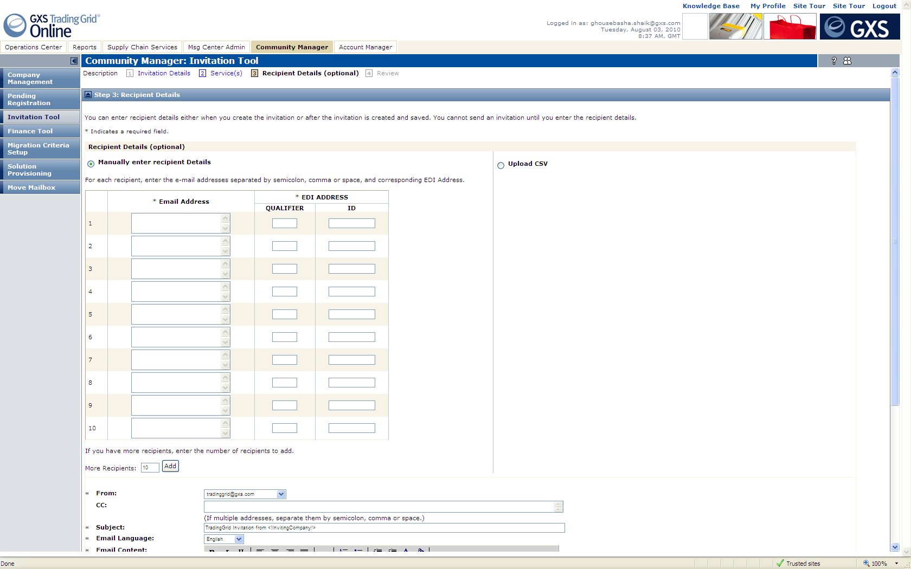
Create Company Invitation
3. Recipients: If option “Manually Enter for each Recipient” is selected for invitee’s EDI address, such a page is displayed.

Slide 22
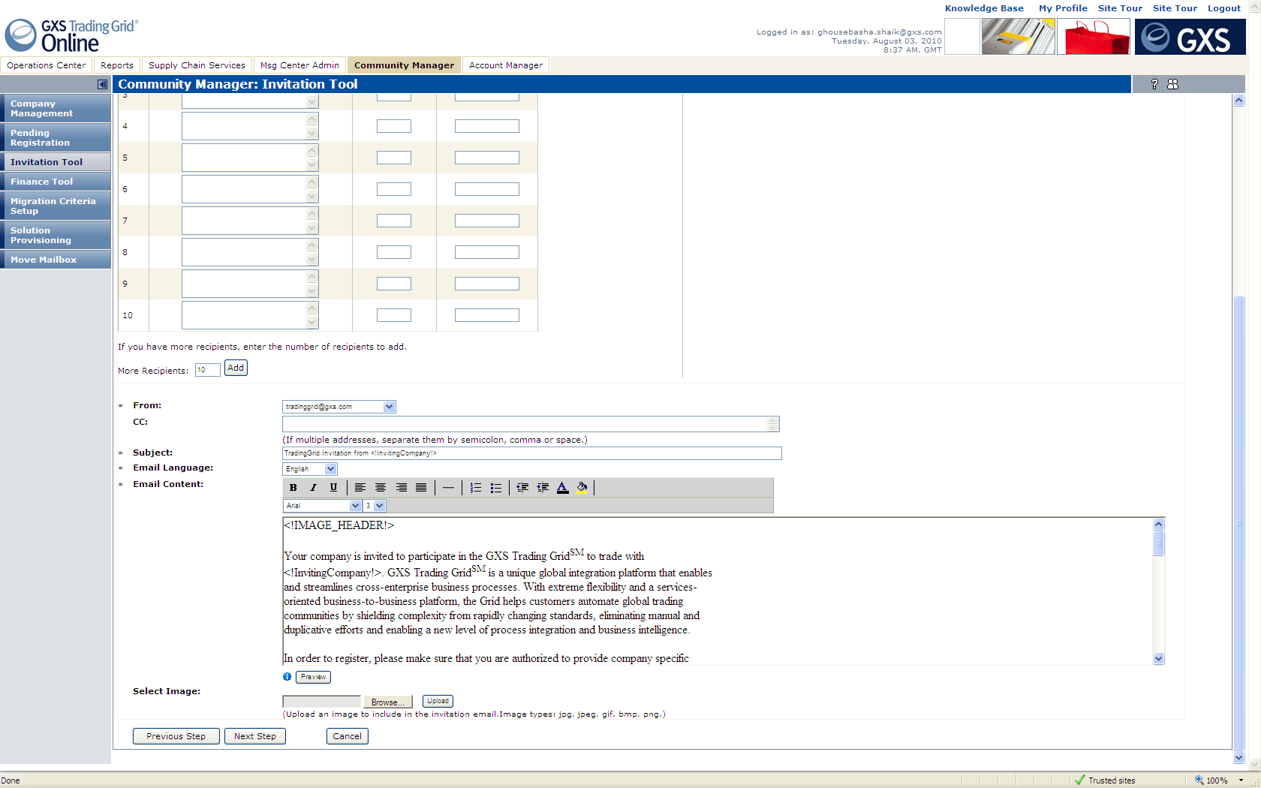
Create Company Invitation
3. Recipients: Edit the email content or select email language.

Slide 23
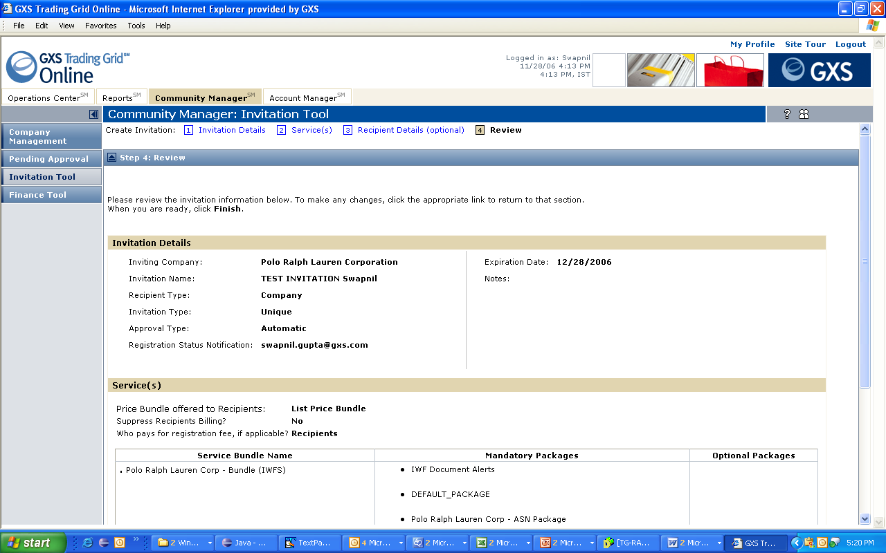
Create Company Invitation
4. Review: Invitation could either be saved or sent out. Saved invitations could later be re-visited, edited and sent.

Slide 24
Self-Registration
Company Self-Registration involves creating an identity of new Companies and their Users, on Trading Grid, essential to their using services offered on the Trading Grid.
New companies and users register on Trading Grid Online and subscribe to TGMS, IWFS, File Services, TGE, OLV etc. such that they are (almost) all set to transact and use the services.
Registration always requires an invitation code, which is generated upon creation of a company or user invitation (which in turn captures the recipients, services, pricing and other details).
Steps involved in new Company Registration flow:
Overview
Subscribe to Services you are invited to.
Accept Terms and Conditions.
Select the pricing option from the options you are offered.
Mailbox creation information if applicable.
EDI address creation information if applicable.
Company Profile.
First User profile.
Trading Partnership information if applicable.
Review and Submit.

Slide 25
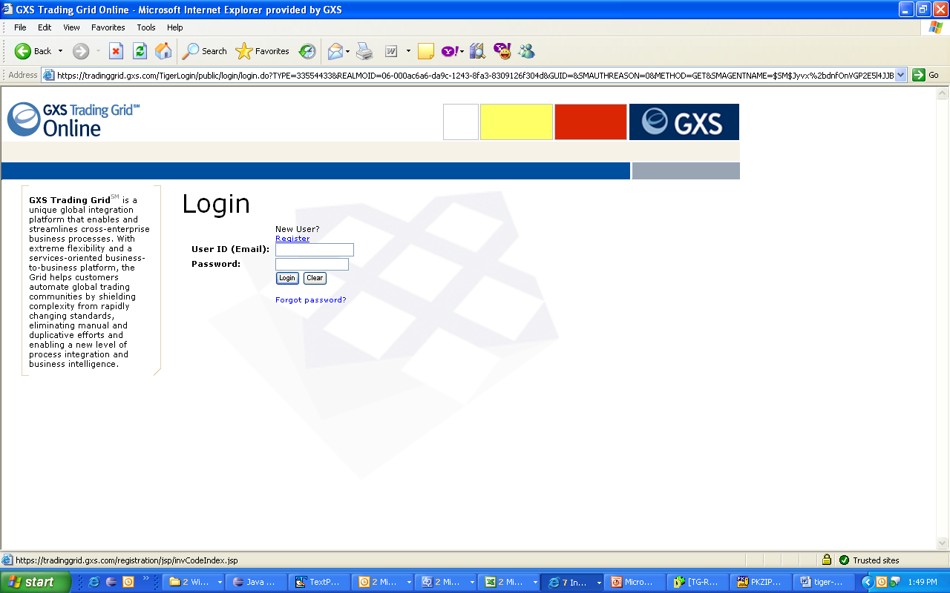
TG-Company Registration TG Portal Login Page – Click ‘Register’ to begin registering.

Slide 26
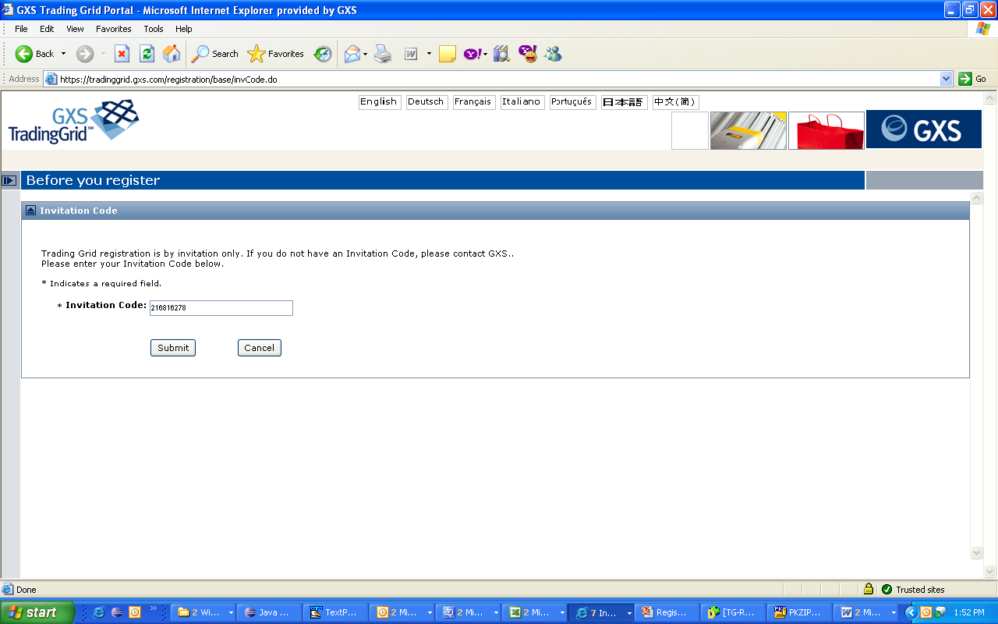
TG-Company Registration Enter Invitation code (included in invitation e-mail)

Slide 27
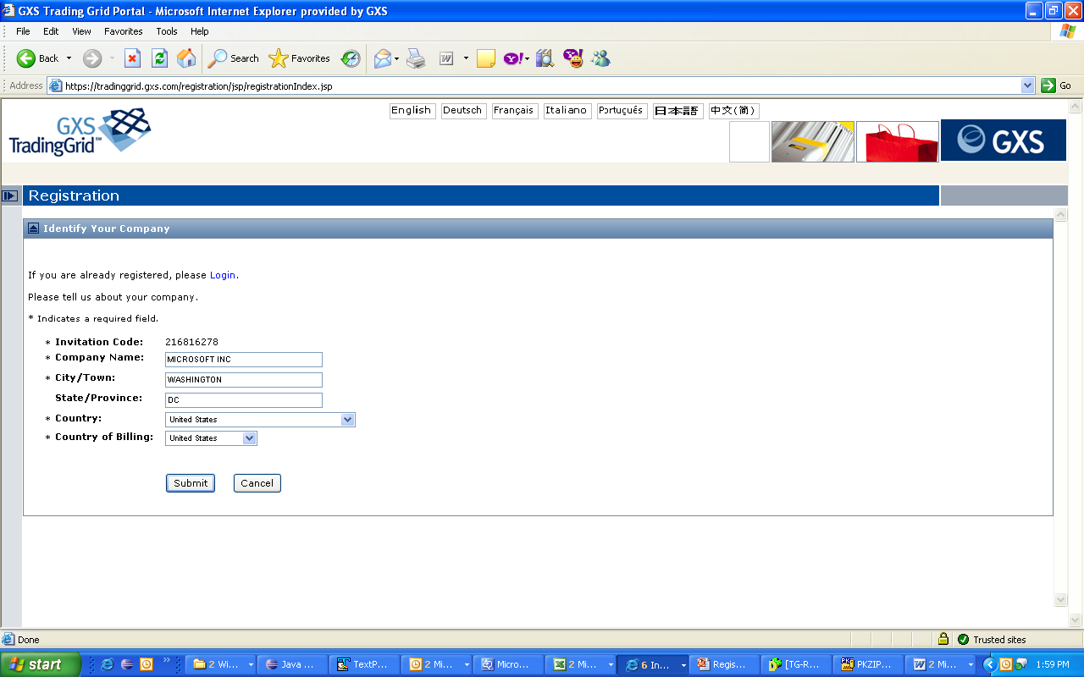
TG-Company Registration Identify your company – Company Name, city, country used for company duplication check.

Slide 28
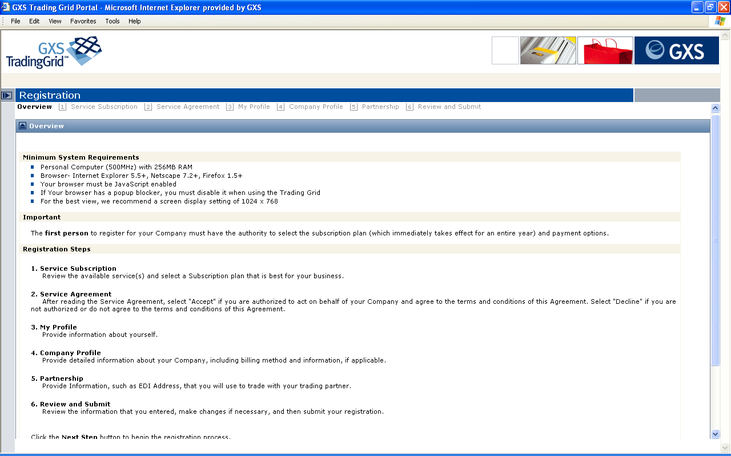
TG-Company Registration Overview Step.

Slide 29
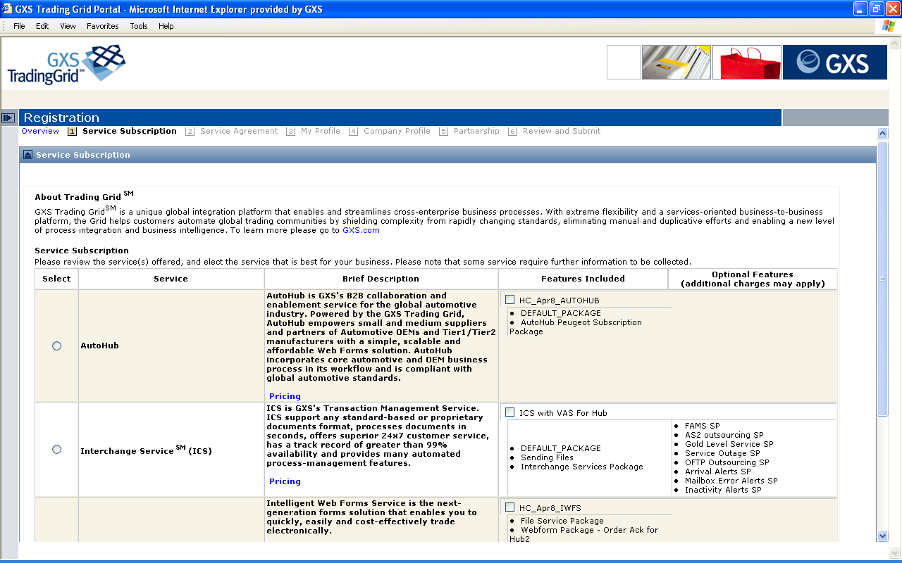
TG-Company Registration 1. Service Subscription: Select one from offered Services.

Slide 30
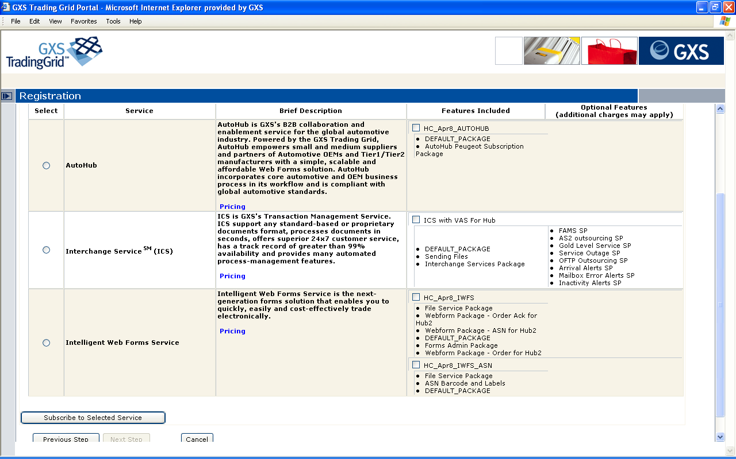
TG-Company Registration 1. Service Subscription: Autohub, ICS and IWFS are the 3 primary (independent) services supported today.

Slide 31
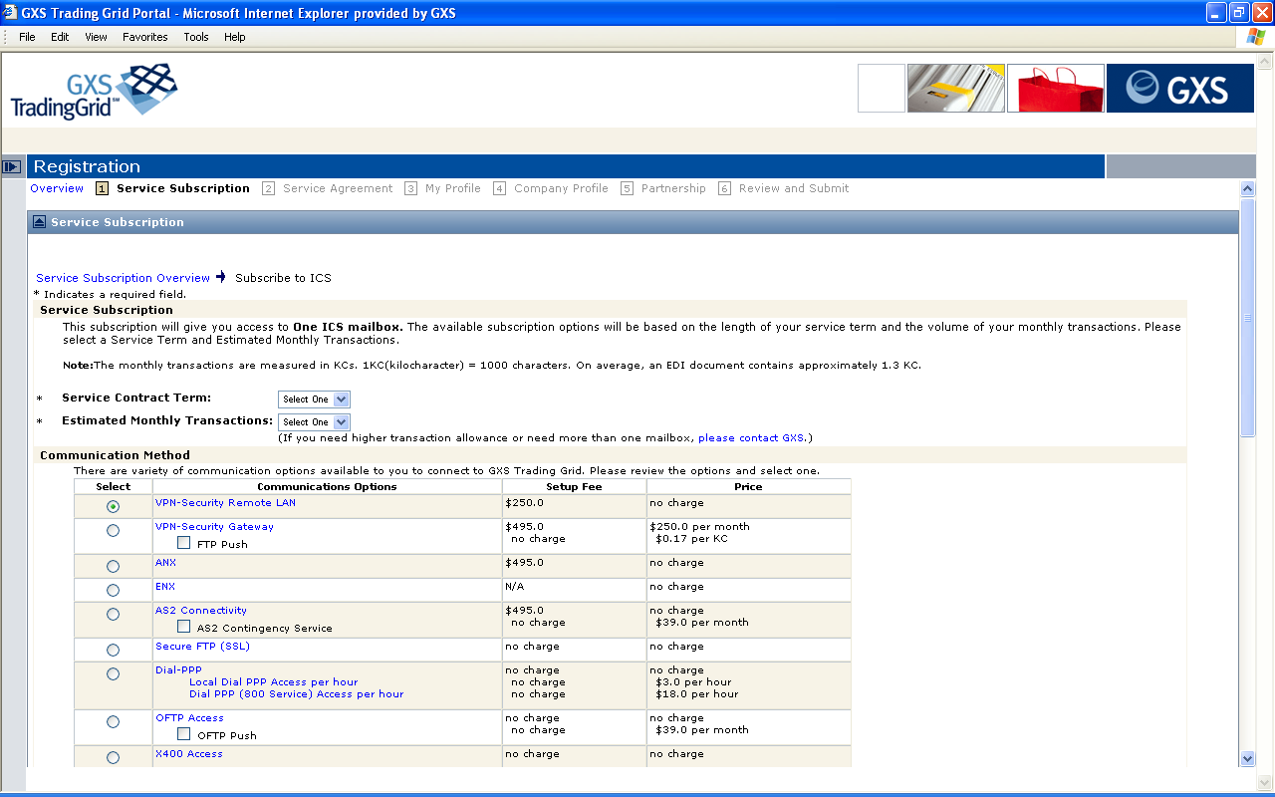
TG-Company Registration 1. ICS Subscription Detail. This page shows if ICS service was selected in previous step.

Slide 32
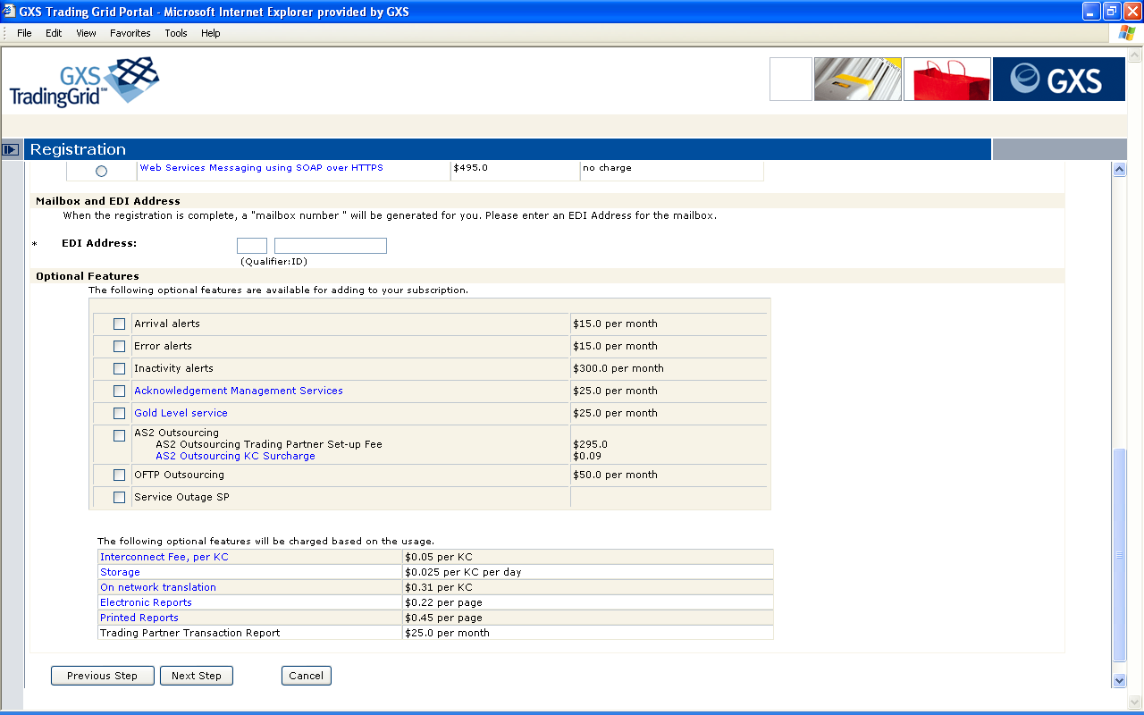
TG-Company Registration 1. ICS Subscription Details: Est. monthly Transactions, Contract Term, Communication Options, VAS options.

Slide 33
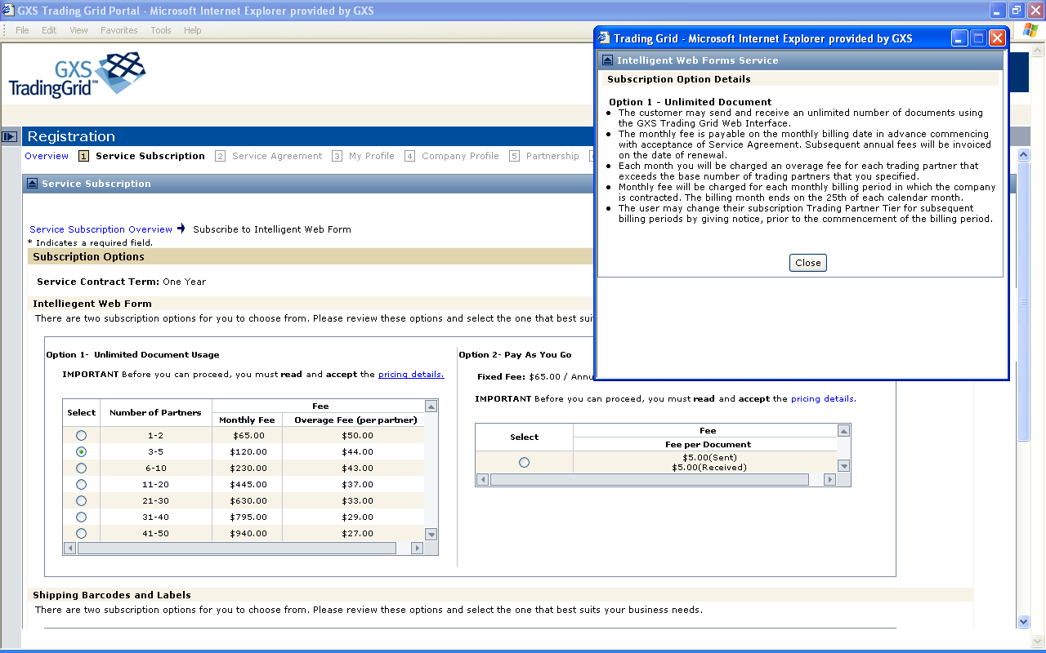
TG-Company Registration 1. IWFS Subscription: If invitee pays UDS and PAYG are the 2 pricing options. UDS Pricing Details shown below:

Slide 34
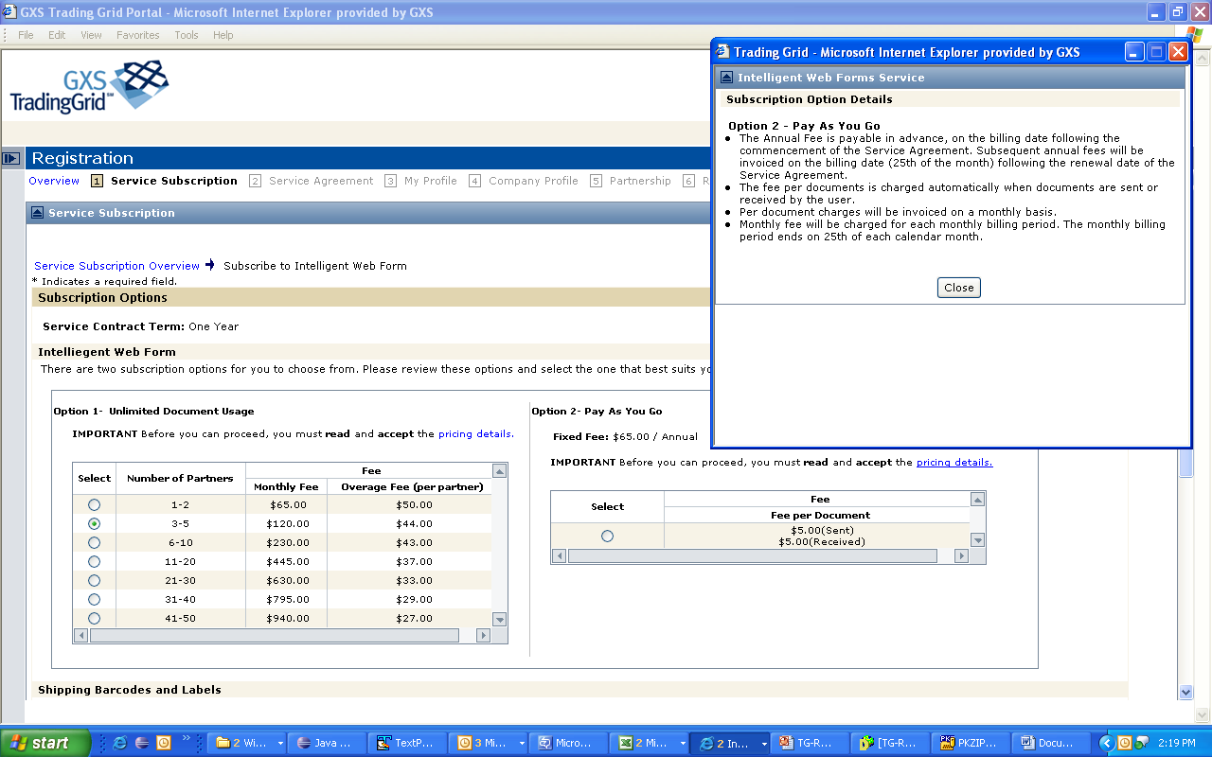
TG-Company Registration 1. IWFS Subscription: If invitee pays UDS and PAYG are 2 pricing options. PAYG pricing details shown below:

Slide 35
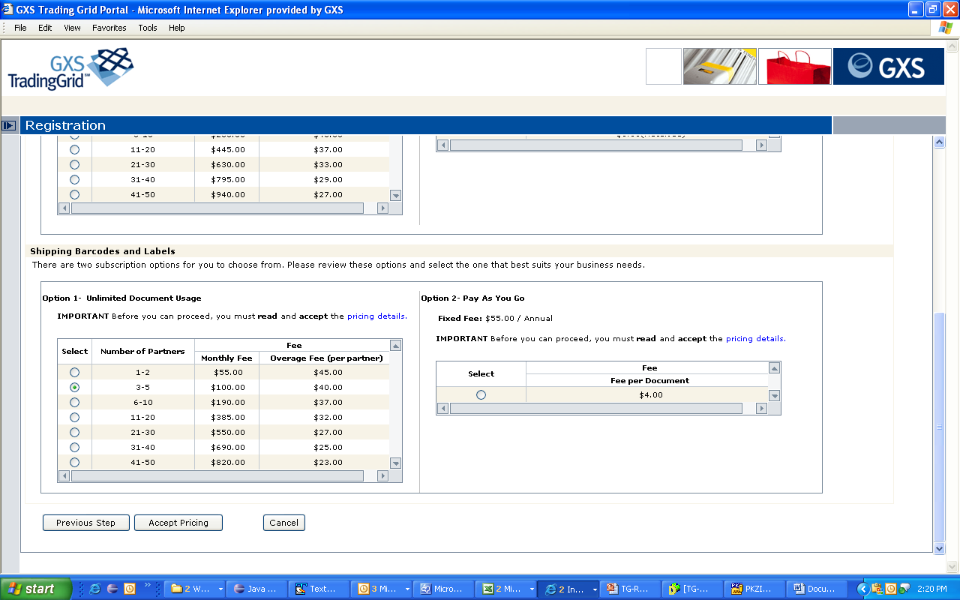
TG-Company Registration 1. IWFS Subscription: Shipping Barcodes and Labels is additional billable service which may be packaged along.

Slide 36
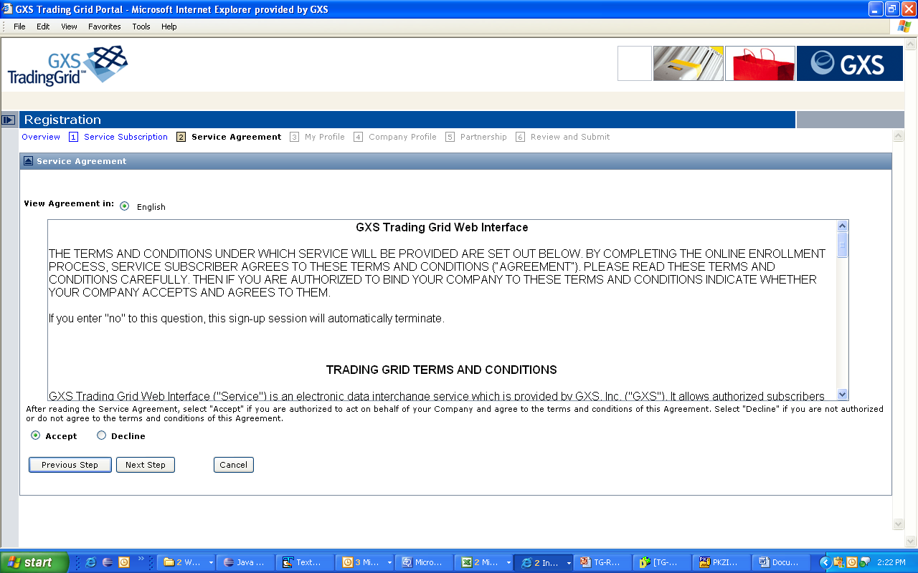
TG-Company Registration 2. Terms & Conditions: T&C content depends on billing country selected initially. Accept T&C.

Slide 37
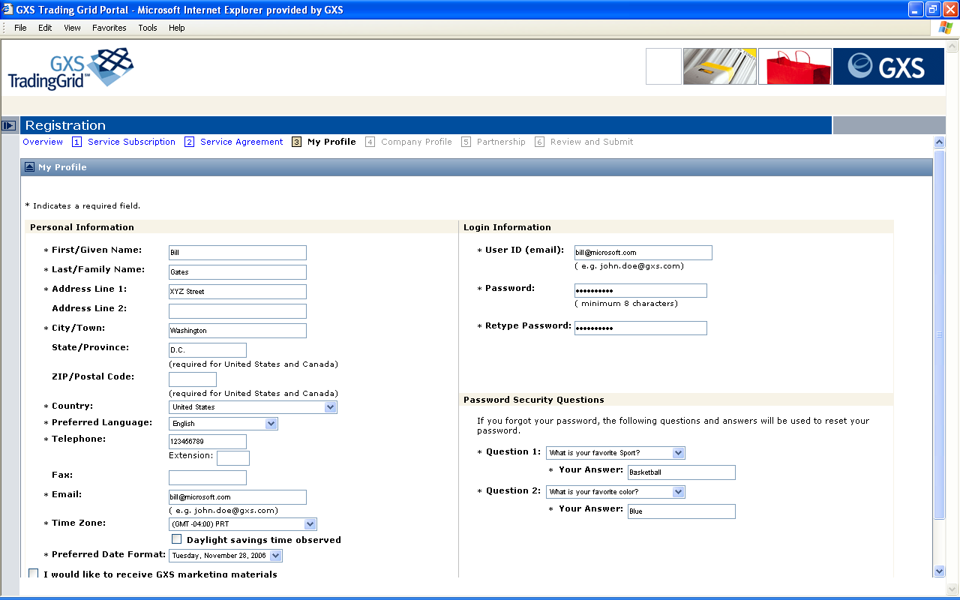
TG-Company Registration 3. My Profile: Registering user’s profile. Company registration creates new company and first user.

Slide 38
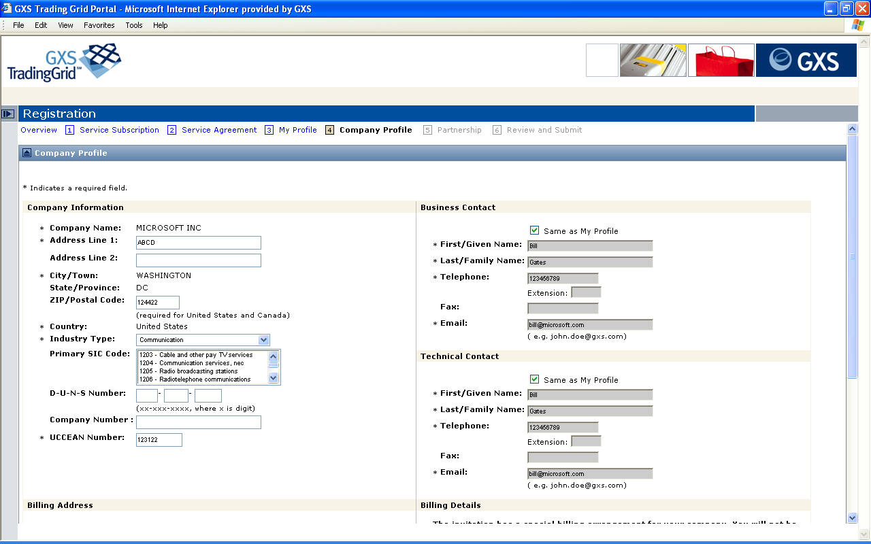
TG-Company Registration 4. Company Profile: Company Information, Business Contact, Technical Contact.

Slide 39
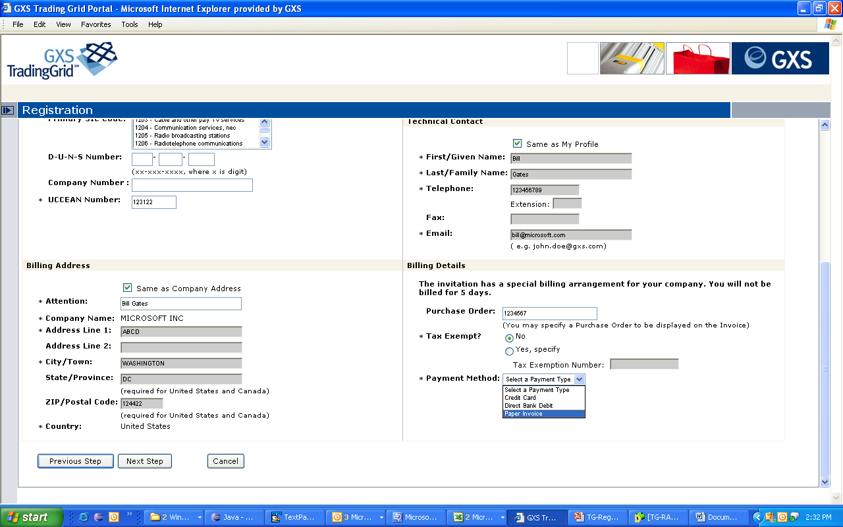
TG-Company Registration 4. Company Profile: Billing Address, Billing Details are not shown if company is not paying (Hub pay scenario).

Slide 40
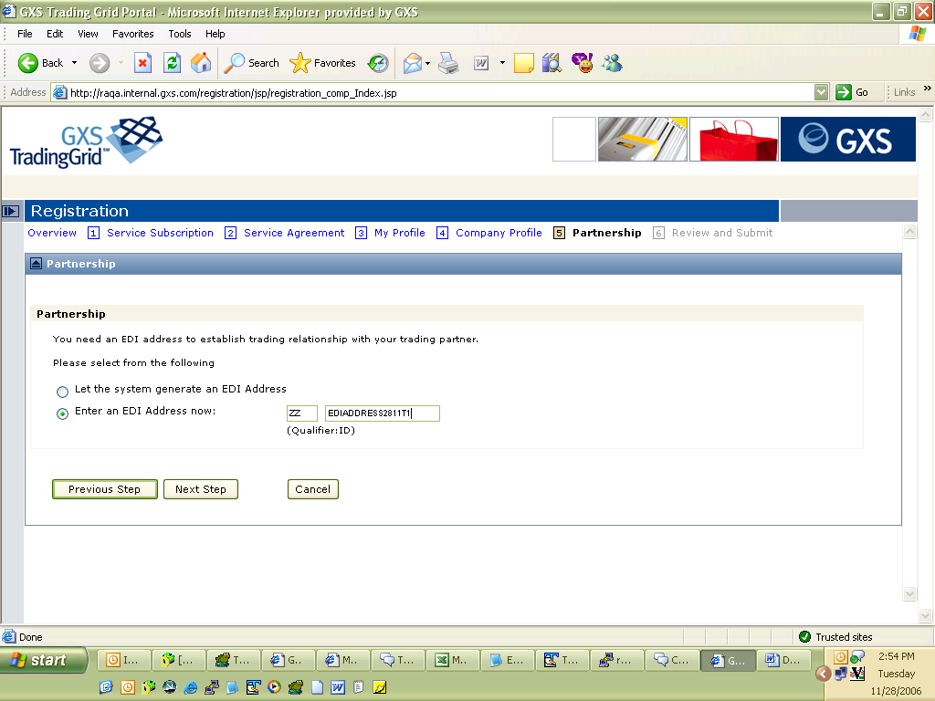
TG-Company Registration 5. Partnership: This screen is applicable to IWFS / Autohub registration where EDI address needs to entered in registration.

Slide 41
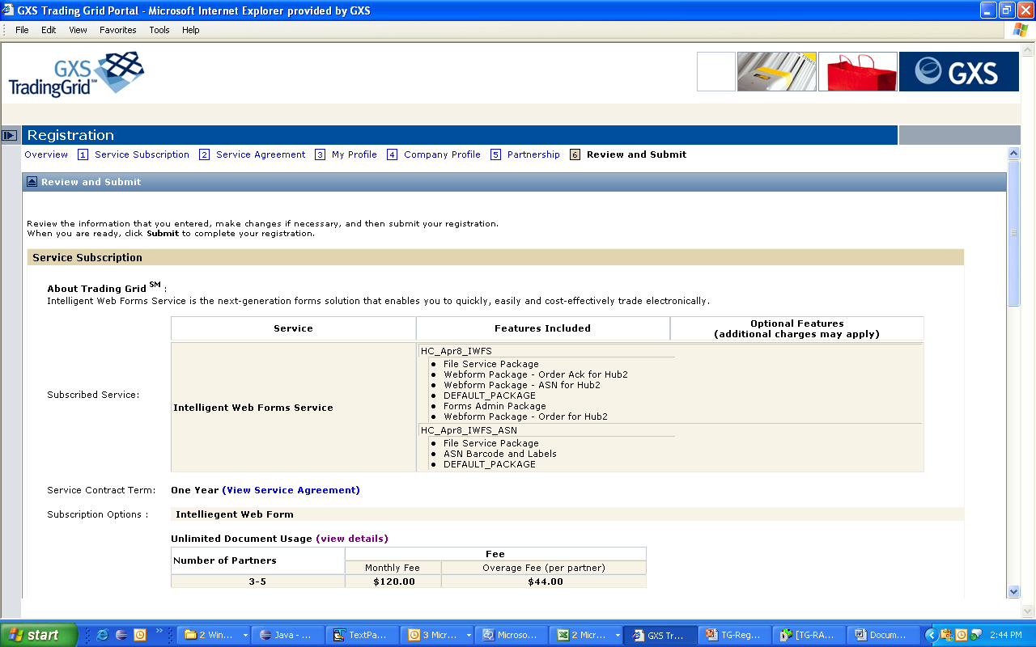
TG-Company Registration 6. Review & Submit

Slide 42
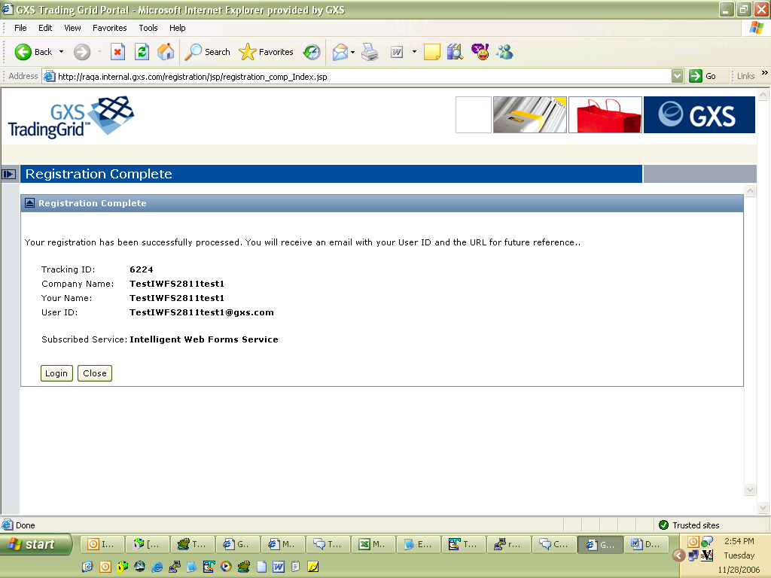
TG-Company Registration Registration Complete: IWFS registration.

Slide 43
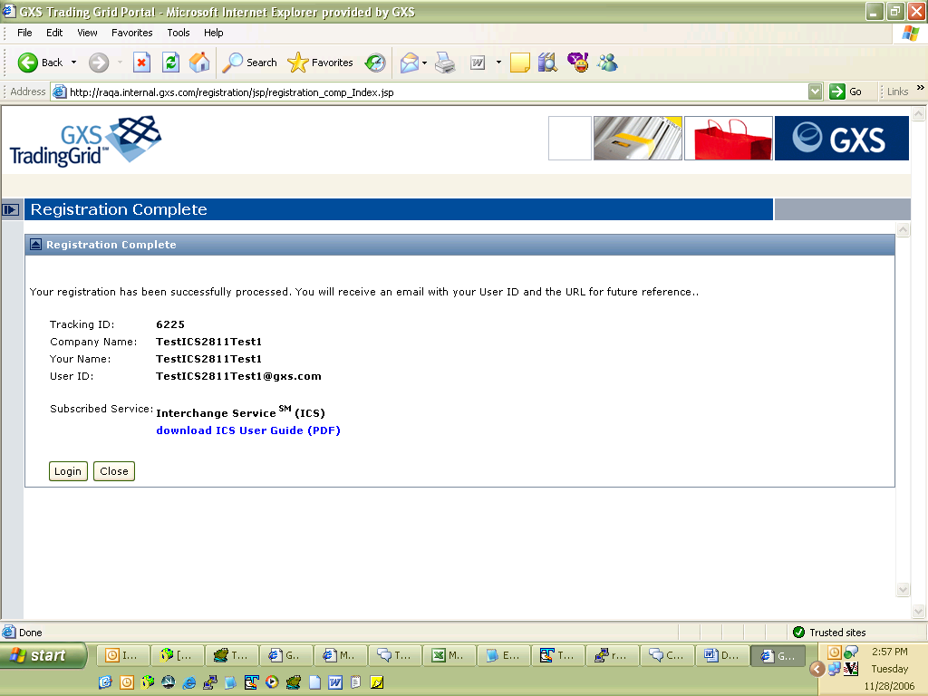
TG-Company Registration Registration Complete: ICS registration.

Slide 44
Approval of Registration
Identity of Company / User is not created in TG system till registration is approved.
Registration may be auto-approved, or may require manual approval by the administrators / inviter.
Upon approval of a registration the new company / user is notified via email notification.

Slide 45
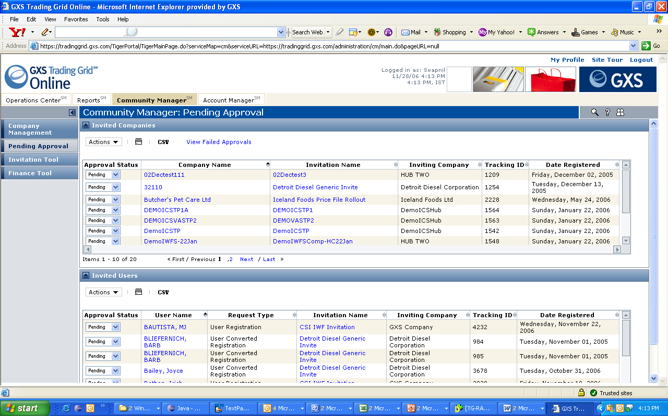
Manual Approval of Registration

Slide 46
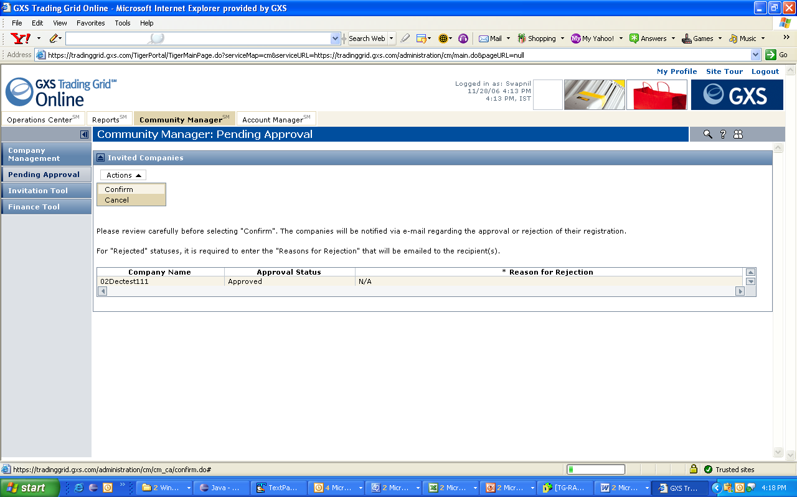
Manual Approval of Registration

Slide 47
Registration-Approval Data flow
2. Set Registration Status = PENDING_MANUAL /
PENDING_AUTO /
PENDING_USERCONVERTED
Registration
Approval Process
3. Set Registration Status = APPROVE / REJECT
Registration Data Store
Invitation
1. Company / User invitation
4. APPROVED Registration
IM
TGMS
ACCOUNTING
FIA
Administration

Slide 48
Approval of TGMS Company
Create Mailbox and initial EDI Address of New Company in TGMS.
Create New Company in IM.
Create Mailbox and EDI Address in IM.
Create BU Subscription to services selected in IM.
Create Mailbox subscription to VAS services in ICS and IM.
Create Business Partner Relationship between Inviter and New company.
Create Trading Partnership between Inviter and New Company EDI Address in ICS.
Create Trading Partnership between Inviter and New Company EDI Address in IM.
Submit ICS pricing selection into FIA.
Create first user in IM.
Grant first user access to Account Manager.
Grant first user access to all services to which BU is subscribed to.
Send email notification.

Slide 49
Approval of IWF Company
Create Mailbox and initial EDI Address of New Company in TGMS.
Create New Company in IM.
Create Mailbox and EDI Address in IM.
Create BU Subscription to services selected in IM.
Create Trading Partnership between Inviter and New Company EDI Address in ICS.
Create Trading Partnership between Inviter and New Company EDI Address in IM.
Submit pricing / billing information to TG-Accounting.
Submit Mailbox information into FIA.
Create first user in IM.
Grant first user access to Account Manager.
Grant first user access to all services to which BU is subscribed to.
Add New Company EDI address to TGPART group.
Create Auto-forward for document flowing from Invitee EDI address to New Company EDI address.
Send email notification.

Slide 50
FEATURE DESCRIPTION
COMPANY & USER MANAGEMENT
REFER APPLICATION DEMO

Slide 51
FEATURE DESCRIPTION
GXS USER - ADMINISTRATIVE CAPABILITIES
REFER APPLICATION DEMO

Slide 52
Administrative Capabilities for GXS user
Act on Behalf of Customer users
My Support List
Elaborate Search Options
Company
User
Trading Partnerships
Invitations
Solution Provisioning – Template based creation for Service Offerings for customers.

Slide 53
Service Bundle Templates
Service Bundle Template is an aggregation of features included as Mandatory or Optional.
You might want to create a Service Bundle Template if you see a scenario where a category of Service Offering may be offered in different flavors where for each flavor you could create a new instance of Service Bundle.
Idea behind creating this Service Bundle Template is to put together set of features / Subscription Packages using which one or more Service Offerings i.e. Service Bundles may be created.
When creating Service Bundle from Service Bundle Template, Mandatory features are necessarily included in the Service Bundle, optional features may or may not be included. If included may be included Optional or Mandatory.
Service Bundle Templates could also contain Subscription Package templates.
Please refer IM documentation for more details.
Service Bundle Template
Contains 0..n, Mandatory / Optional
Used to create 1..n
Service Bundle
Subscription Package
Subscription Package Template

Slide 54
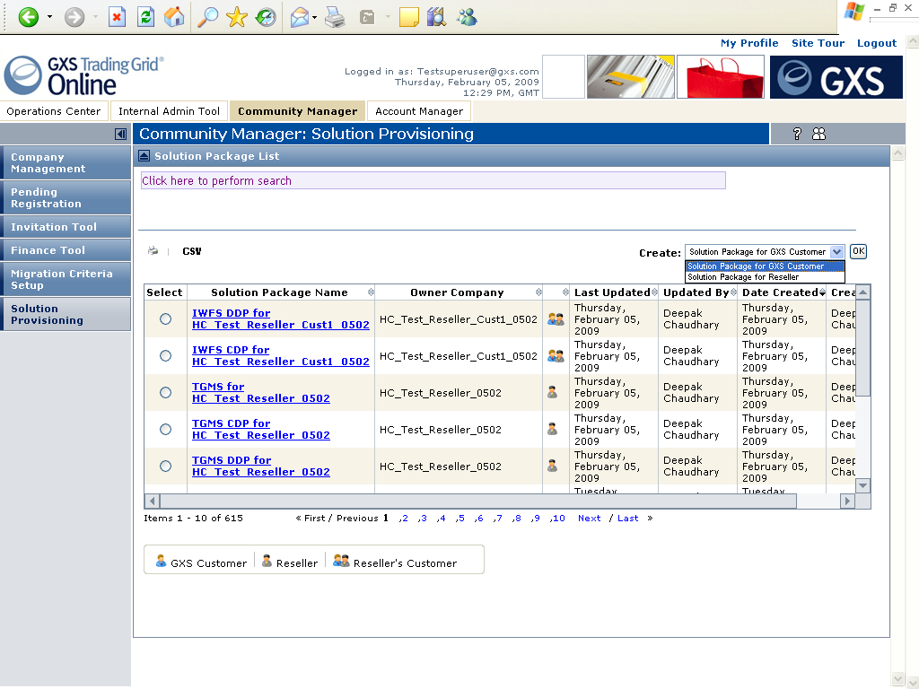
Using Service Bundle Templates
Solution Package as referred to here is same as Service Bundle in IM.

Slide 55
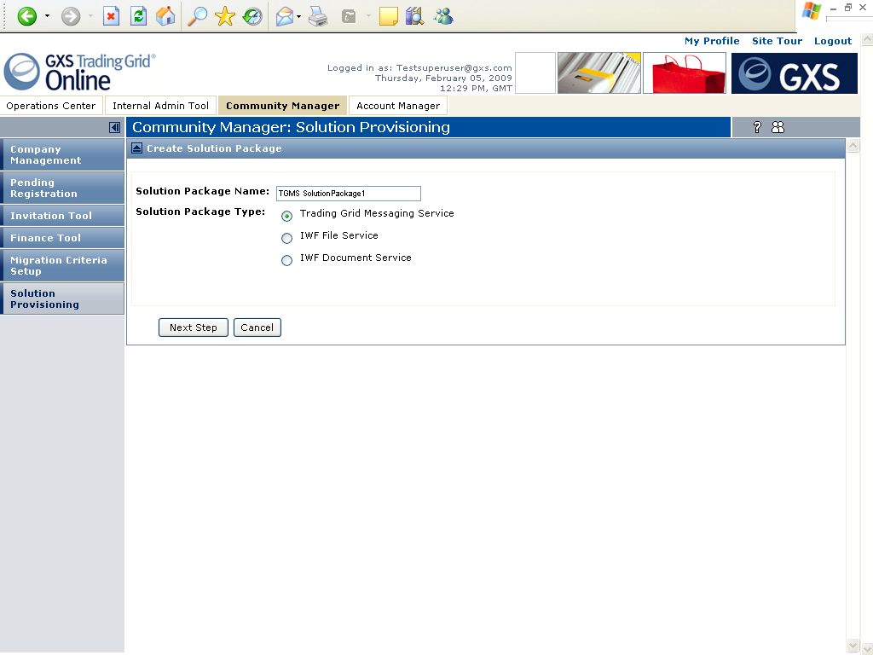
Using Service Bundle Templates
Solution Package as referred to here refers to Service Bundle Template in IM.
Select the Service Bundle Template (3 listed here) to continue with the wizard
helping you with the creation of Service Bundle.

Slide 56
FEATURE DESCRIPTION
SERVICE & SUBSCRIPTION MODEL

Slide 57
Service & Subscription Model
Service Bundle is an independent Service Offering which could be made to a Company / Customer.
Service Bundle
Subscription Packages are features contained within the Service Bundle. Is uniquely indentified by Subscription Map.
Company necessarily gets subscribed to Mandatory Subscription Packages included in a Service Bundle it is subscribed to.
Company may choose to subscribe to Optional Subscription Packages included in a Service Bundle it is subscribed to.
Contains 1..n Mandatory / Optional
Subscription Package
Service Instances are one or more basic/most granular features / sub-features based on which user access within company may be controlled. Is uniquely identified by Service Map.
User of a Company may get subscribed to Service Instance if and only if its parent Company is subscribed to Subscription Package containing the respective Service Instance.
Service may contain one or more Roles to make available different flavors of same feature to different Actors.
Web Policy may be created against an Service Instance for authorization.
Contains 1..n
Contains 1..n
Role
Service Instance
Contains 1..n

Slide 58
Service & Subscription Model & Usage
Service Bundles are expected be created at runtime majorly driven by marketing inputs.
There may be a need to add / delete Subscription Package to / from an Service Bundle or update mandatory / optional flag at runtime based on requirements.
Business / Application Logic is typically NOT a function of Service Bundle.
Service Bundle
Contains 1..n Mandatory / Optional
Subscription Package (features) could be re-used to be included in multiple Service Bundles. Are usually not be created at runtime. Typically create with a new release.
There may be a need to add / delete Service Instance to / from an Subscription Package at runtime based on requirements.
Business / Application Logic is a function of Subscription Package (identified by Subscription Map).
Subscribes to
Subscription Package
Company
May Subscribe to
Contains 0..n
Contains 0..n
Contains 0..n
Mailbox
Owns 0..n
Service Instance would very rarely be created at runtime. Only create with a new release.
There may be a need to update Service Instance at runtime based on requirement changes.
Business / Application Logic is a function of Service Instance (identified by Service Map).
Role
Service Instance
Is Allowed Access to
Is Granted
User

Slide 59
Service & Subscription Model & Usage – More Details
Service Bundle (also referred to as Solution Package in TGO Community Manager )
Some Service Bundles may be set up as sponsored by Hub Companies to be available only for its Spoke Companies. E.g. IWF / OLV for Spokes.
Other Service Bundles are available for subscription for any Company. E.g. TGMS.
Service Bundle
Contains 1..n Mandatory / Optional
Subscription Package
Some Features need to be enabled/ disabled per Mailbox owned by a Company. May be flagged so.
May be Mandatory or Optional , may be visible or invisible.
Subscribes to
Subscription Package
Company
Service Instance
Some SIs need to be flagged as Primary Service to indicate it refers to a Service around which other services revolve and that it can be offered independently of any other primary service. E.g. IWF / OLV / TGMS.
Some SIs need to be Auto-subscribed.
Some SIs need to be flagged to indicate that Service Contacts may be configured against them.
Some SIs are sub-features of parent feature and need to be granted conditional access. [Hierarchy]
May Subscribe to
Contains 0..n
Contains 0..n
Contains 0..n
Mailbox
Owns 0..n
Role
Service Instance
Is Allowed Access to
Is Granted
User

Slide 60
Service & Subscription Model & Usage – More Details
Service Bundle (also referred to as Solution Package in TGO Community Manager )
Some Service Bundles may be set up as sponsored by Hub Companies to be available only for its Spoke Companies. E.g. IWF / OLV for Spokes.
Other Service Bundles are available for subscription for any Company. E.g. TGMS.
Service Bundle
Contains 1..n Mandatory / Optional
Subscription Package
Some Features need to be enabled/ disabled per Mailbox owned by a Company. May be flagged so.
May be Mandatory or Optional , may be visible or invisible.
Subscribes to
Subscription Package
Company
Service Instance
Some SIs need to be flagged as Primary Service to indicate it refers to a Service around which other services revolve and that it can be offered independently of any other primary service. E.g. IWF / OLV / TGMS.
Some SIs need to be Auto-subscribed.
Some SIs need to be flagged to indicate that Service Contacts may be configured against them.
Some SIs are sub-features of parent feature and need to be granted conditional access. [Hierarchy]
May Subscribe to
Contains 0..n
Contains 0..n
Contains 0..n
Mailbox
Owns 0..n
Role
Service Instance
Is Allowed Access to
Is Granted
User

Slide 61
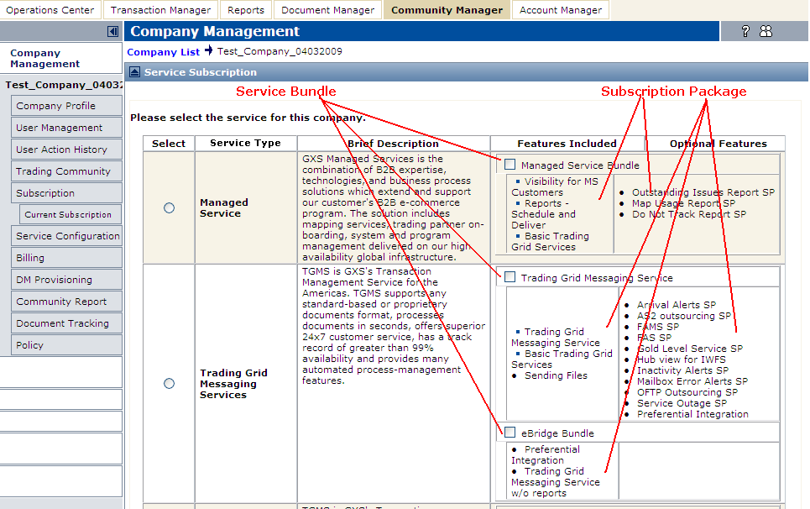
TGO Company Subscription

Slide 62
User Access Control
User can potentially access all features under the umbrella of its companies subscription
User Access to a Feature controlled based on:
Service Instances access
Role
Roles contain Permissions determining fine grained user access to:
Sub-Features
Capability to perform certain actions
Capability of view some data
Scope of data visible
UI Features and functions protected against
Site minder policies created against Service Instances
Permissions (tag libraries used to protect UI resources)

Slide 63
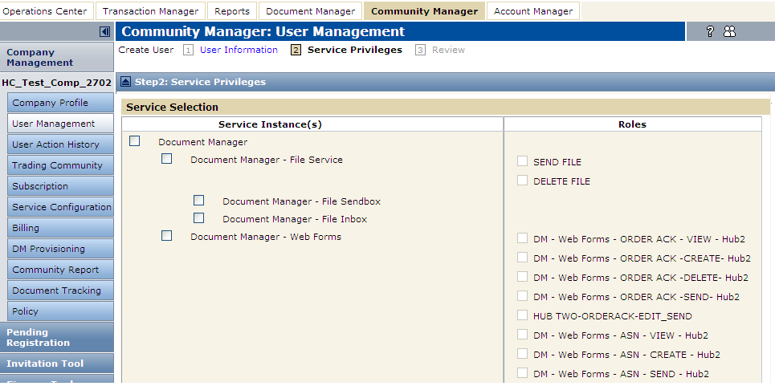
TGO User Subscription

Slide 64
FEATURE DESCRIPTION
SUBSCRIPTION & PRICING
REFER APPLICATION DEMO

Slide 65
FEATURE DESCRIPTION
MESSAGING ADMINISTRATION
REFER APPLICATION DEMO

Slide 66
FEATURE DESCRIPTION
RESELLER SUPPORT

Slide 67
Reseller Support on TG
New Reseller can be created on TG by GXS Admin.
Invitation, Self-Registration, Subscription use-cases extended to support the creation of Reseller’s customers on TG.
Resellers can self administer its community of TGMS, DM-IWF, DM-FS customers.
Resellers can override GXS T&C and offer to its customers. Includes WYSWYG editor for T&C creation and update.
TG service and subscription model extended to allow Resellers to create custom service offerings for its community of customers.

Slide 68
FEATURE DESCRIPTION
SAS 70 COMPLIANCE – INTERNAL USER ADMINISTRATION

Slide 69
Overview
GXS User has access to only desired features, no more no less.
Define and support set of ROLES for GXS Users which are commonly understood and used across different services.
A common understanding of what should a service on Trading Grid do to support / implement a new feature which needs to be made available to users with one of the ROLES, which should be commonly understood across all services.

Slide 70
Roles for GXS User
GXS Super Admin
GXS Admin
GXS Lead Dev/QA
GXS Tier 1 & 2 Support
GXS Tier 3 (ICE/ACE) Support
GXS PPM
GXS GPM
GXS Sales
GXS Program Manager
GXS Finance

